Slide 1
ICS 3103:Data Communications Modulation Techniques
By Cheruiyot W.K, PhD
JKUAT-SCIT
Computing Department

Slide 2
Waves
Sound is converted into electricity by a telephone and then transmitted as an analog signal.
These waves have 3 fundamental characteristics:
Amplitude, meaning the height (intensity) of the wave
Frequency, which is the number of waves that pass in a single second and is measured in Hertz (cycles/second) (wavelength, the length of the wave from crest to crest, is related to frequency.).
Phase is a third characteristic that describes the point in the wave’s cycle at which a wave begins and is measured in degrees. (For example, changing a wave’s cycle from crest to trough corresponds to a 180 degree phase shift).

Slide 3
Waves
After encoding the binary data, the data is now ready to be transmitted through the physical channel
In order to transmit the data in the physical channel we must convert the data back to an electrical signal
Convert it back to an analog form
This process is called modulation

Slide 4
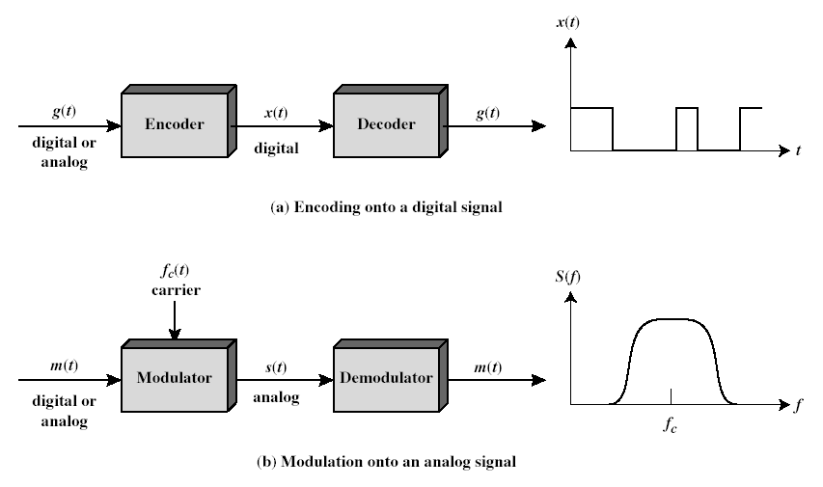
Encoding and Modulation

Slide 5
Modulation
Modulation is the process of encoding source data onto a carrier signal with frequency f_{c}.
The frequency of the carrier signal is chosen to be compatible with the transmission medium being used.
Modulation techniques involve operation on one or more of the three parameters: amplitude, frequency, and phase
According to the input source signal m(t) (either analog or digital), which is called baseband signal (or modulating signal) , the carrier signal f_{c}(t) will be modulated into modulated signal s(t).

Slide 6
Encoding/modulation Techniques
Digital data, digital signal
The equipment for encoding digital data into a digital signal is less complex and less expensive than digital-to-analog modulation equipment.
Analog data, digital signal
Conversion of analog data (e.g., voice, video) to digital form permits the use of modern digital transmission & switching.
Digital data, analog signal
Optical system and unguided media (wireless system) only propagate analog signals.
Analog data, analog signal
Baseband: easy and cheap, e.g., in voice-grade telephone lines, voice signals are transmitted over telephone lines at their original spectrum
Modulation permits frequency division multiplexing, e.g., AM/FM radios

Slide 7
(I) Digital Data, Digital Signal
Digital signal is a sequence of discrete, discontinuous voltage pulses.
Each pulse is a signal element.
Binary data are transmitted by encoding the bit stream into signal elements.
In the simplest case, one bit is represented by one signal element.
E.g., 1 is represented by a lower voltage level, and 0 is represented by a higher voltage level

Slide 8
Terminologies
Unipolar
If all signal elements have the same algebraic sign (all positive or all negative), then the signal is unipolar.
Polar
One logic state represented by positive voltage, the other by negative voltage
Data rate
Rate of data transmission measured in bps: bits per second
Duration or length of a bit
Time taken for transmitter to emit the bit
Modulation rate
Rate at which the signal level changes
Measured in baud: signal elements per second
Mark and Space
Mark: Binary 1
Space: Binary 0
How are they related?

Slide 9
Interpreting Signals at the Receiver
The receiver needs to know
The timing of each signal element, i.e., when a signal element begins and ends
signal levels
These tasks are performed by sampling each element position in the middle of the interval and comparing the value to a threshold.
Factors affecting successful interpreting of signals
Signal-to-noise ratio (SNR)
Data rate
Bandwidth
Some principles:
An increase in data rate increases bit error rate (BER)
An increase in SNR decreases BER
An increase in bandwidth allows an increase in data rate
Another factor that can improve performance:
Encoding scheme: the mapping from data bits to signal elements

Slide 10
Evaluation of Encoding Schemes (1)
Signal Spectrum
Lack of high frequencies reduces required bandwidth
Lack of dc component allows ac coupling via transformer, providing electrical isolation and reducing interference
Concentrate power in the middle of the bandwidth
Clocking
Need to determine the beginning and end of each bit
Synchronizing transmitter and receiver
Use external clock, which is expensive; or
Synchronization mechanism based on the transmitted signal

Slide 11
Comparison of Encoding Schemes (2)
Error detection
Various error-detection techniques will be covered in Chapter 9
Some error detection capability can be built into signal encoding scheme
Signal interference and noise immunity
Some codes are better than others in the presence of noise
Performance is usually expressed in terms of BER
Cost and complexity
Higher signal rate (thus data rate) leads to higher cost
Some codes require a signal rate greater than the actual data rate

Slide 12
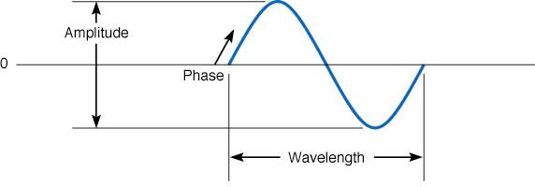
Figure 1.0 Sound wave

Slide 13
Modulation
In modulation process, we need to use two types of signals:
Information, message or transmitted signal
Carrier signal
Let’s assume the carrier signal is of a sinusoidal type of the form x(t) = A sin (wt + θ )
Modulation is letting the message signal to change one of the carrier signal parameters

Slide 14
Modulation
If we let the carrier signal amplitude changes in accordance with the message signal then we call the process amplitude modulation
If we let the carrier signal frequency changes in accordance with the message signal then we call this process frequency modulation

Slide 15
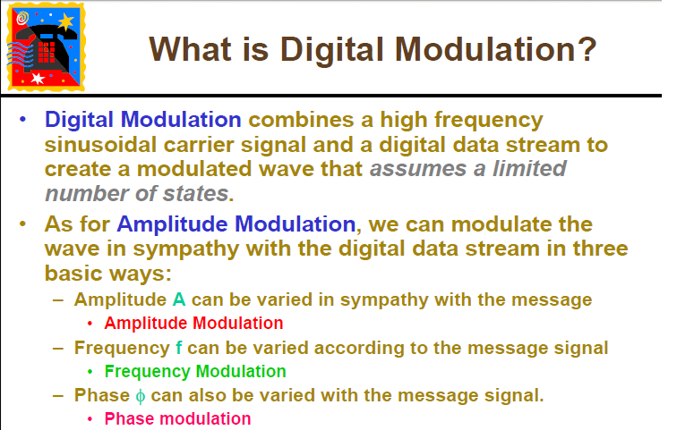

Slide 16
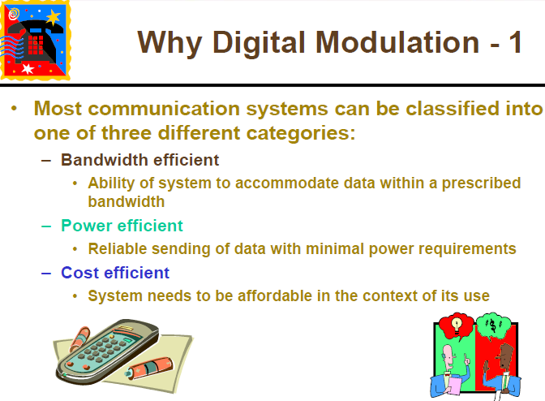

Slide 17
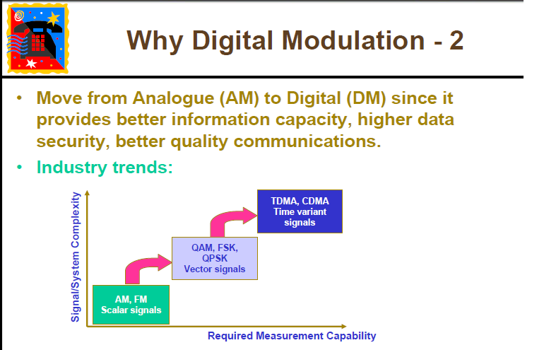

Slide 18
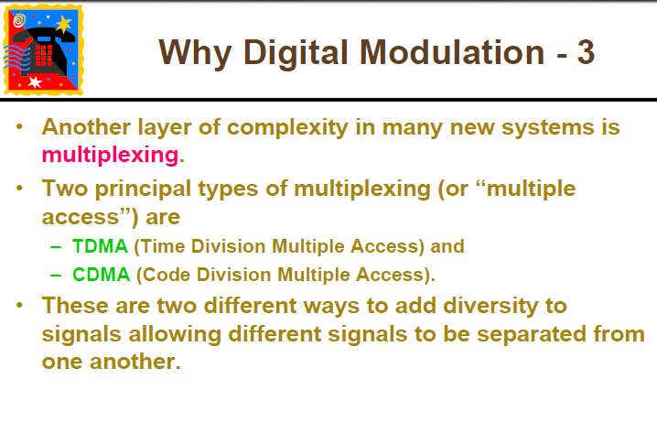

Slide 19
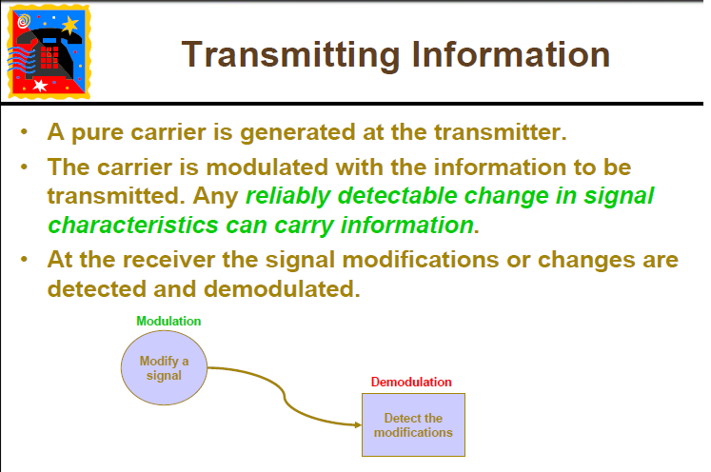

Slide 20
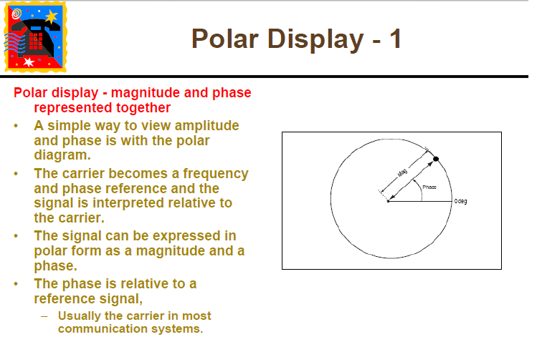

Slide 21
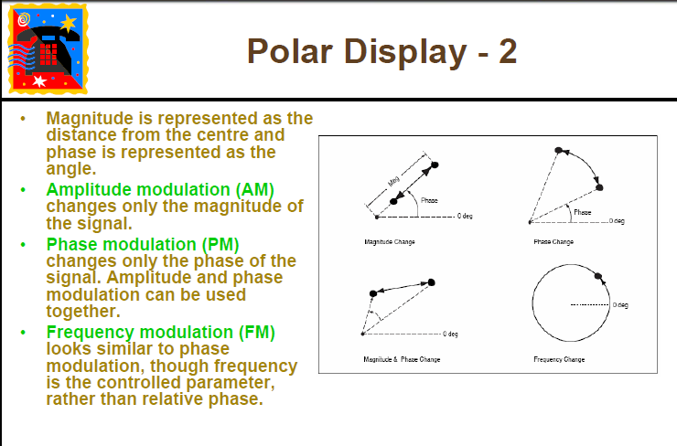

Slide 22
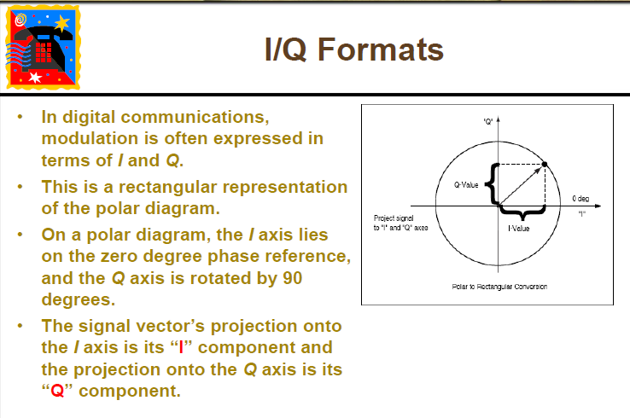

Slide 23
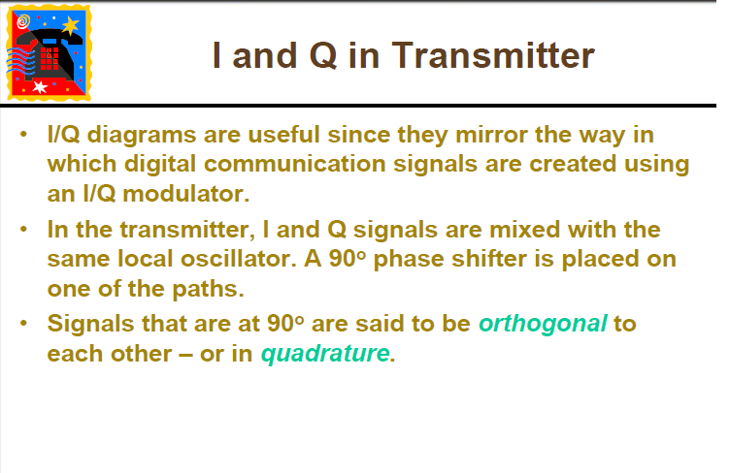

Slide 24
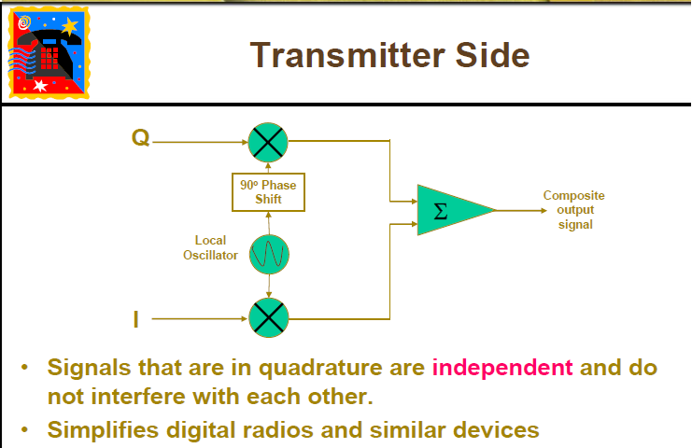

Slide 25
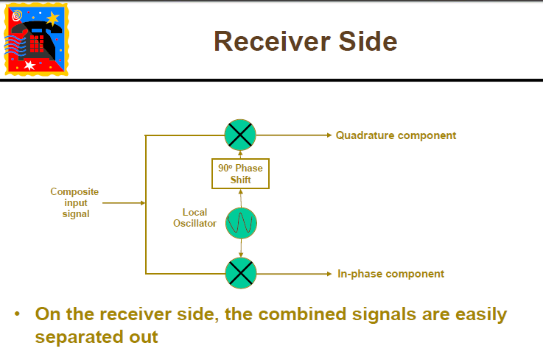

Slide 26
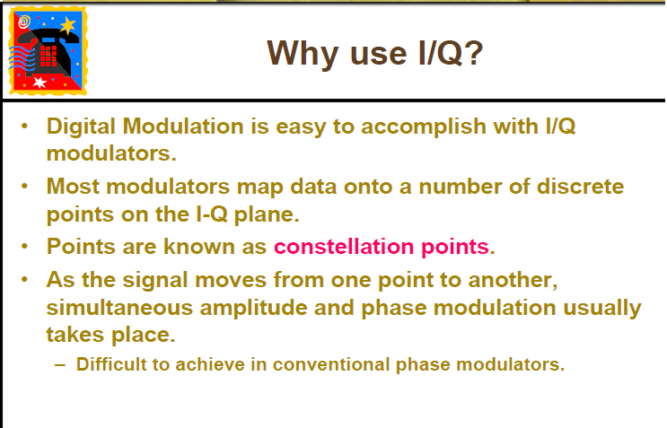

Slide 27
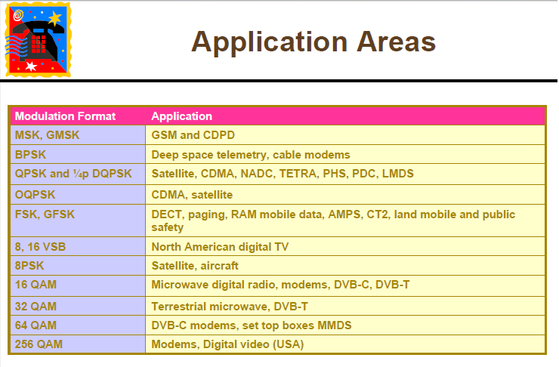

Slide 28
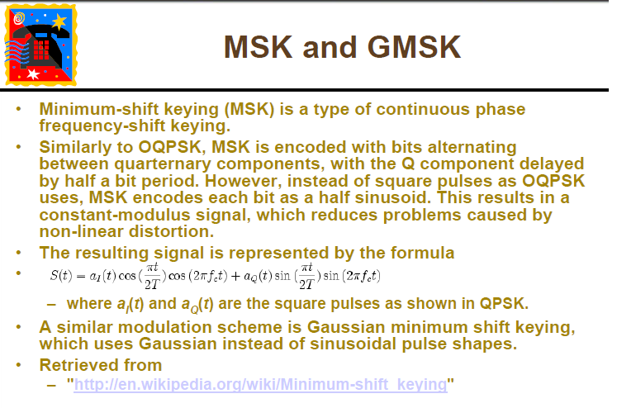

Slide 29
Digital Data Transmission
There are two types of Digital Data Transmission:
1) Base-Band data transmission
Uses low frequency carrier signal to transmit the data
2) Band-Pass data transmission
Uses high frequency carrier signal to transmit the data

Slide 30
Baseband Transmission
Digital transmission is the transmission of electrical pulses. Digital information is binary in nature in that it has only two possible states 1 or 0. Sequences of bits encode data (e.g., text characters).
Digital signals are commonly referred to as baseband signals.
In order to successfully send and receive a message, both the sender and receiver have to agree how often the sender can transmit data (data rate).
Data rate often called bandwidth – but there is a different definition of bandwidth referring to the frequency range of a signal!

Slide 31
Base-Band Data Transmission
Base-Band data transmission = Line coding
The binary data is converted into an electrical signal in order to transmit them in the channel
Binary data are represented using amplitudes for the 1’s and 0’s
We will present some of the common base-band signaling techniques used to transmit the information

Slide 32
Encoding Schemes
Nonreturn to Zero (NRZ)
Nonreturn to Zero-Level (NRZ-L)
Nonreturn to Zero Inverted (NRZI)
Multilevel Binary
Bipolar-AMI
Pseudoternary
Biphase
Manchester
Differential Manchester
Scrambling techniques
B8ZS
HDB3

Slide 33
Non-Return to Zero (NRZ)
The “1” is represented by some level
The “0” is represented by the opposite
The term non-return to zero means the signal switched from one level to another without taking the zero value at any time during transmission.

Slide 34
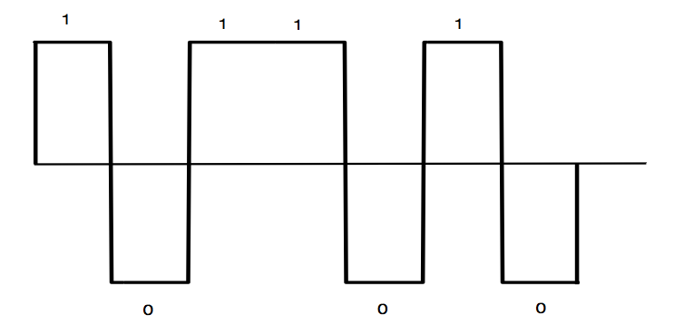
NRZ - Example
We want to transmit m=1011010

Slide 35
Unipolar Return to Zero (Unipolar RZ)
Binary “1” is represented by some level that is half the width of the signal
Binary “0” is represented by the absence of the pulse

Slide 36
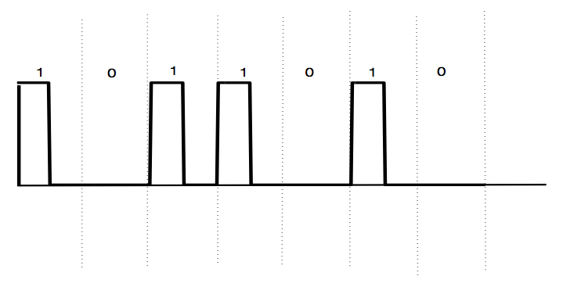
Unipolar RZ - Example
We want to transmit m=1011010

Slide 37
Bipolar Return to Zero (Bipolar RZ)
Binary “1” is represented by some level that is half the width of the signal
Binary “0” is represented a pulse that is half width the signal but with the opposite sign

Slide 38
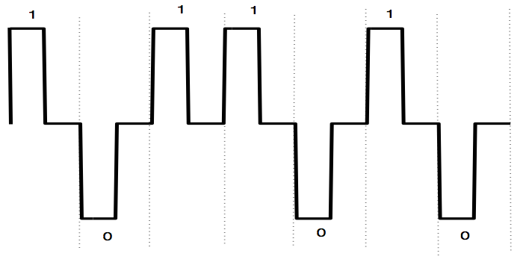
Bipolar RZ - Example
We want to transmit m=1011010

Slide 39
Return to Zero Alternate Mark Inversion (RZ-AMI)
Binary “1” is represented by a pulse alternating in sign
Binary “0” is represented with the absence of the pulse

Slide 40
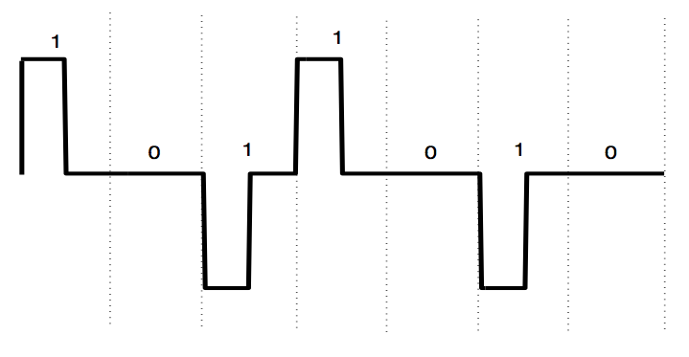
RZ-AMI - Example
We want to transmit m=1011010

Slide 41
Non-Return to Zero – Mark (NRZ-Mark)
Also known as differential encoding
Binary “1” represented in the change of the level
High to low
Low to high
Binary “0” represents no change in the level

Slide 42
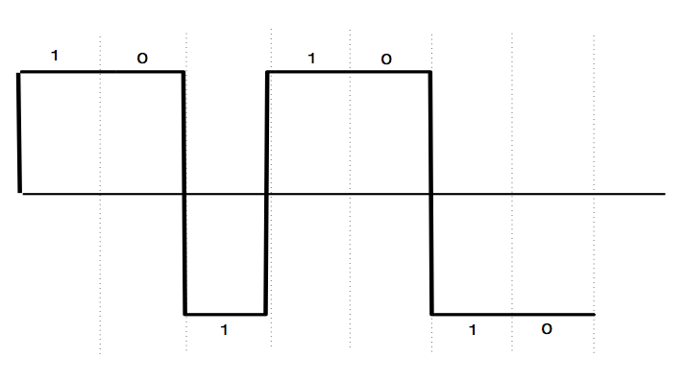
NRZ-Mark - Example
We want to transmit m=1011010

Slide 43
Manchester coding (Biphase)
Binary “1” is represented by a positive pulse half width the signal followed by a negative pulse
Binary “0” is represented by a negative pulse half width the signal followed by a positive pulse

Slide 44
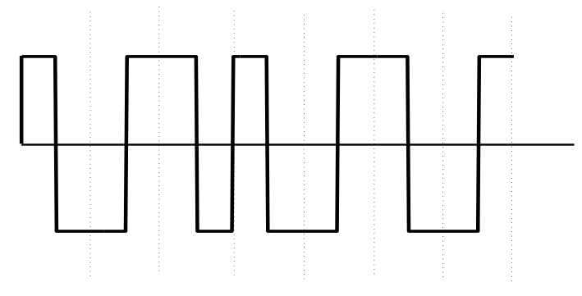
Manchester coding - Example
We want to transmit m=1011010

Slide 45
Scrambling techniques
We present two techniques used to replace a long sequence of zeros by some special type of sequences
Bipolar 8 Zero substitution (B8ZS)
High Density bipolar 3 Zeros (HDB3)

Slide 46
Bipolar 8 Zero substitution (B8ZS)
Used in North America to replace sequences with 8 zeros with a special sequence according to the following rules:
If an octet (8) of all zeros occurs and the last voltage pulse preceding this octet was positive, then 000+-0-+
If an octet of all zeros occurs and the last voltage pulse preceding this octet was negative, then 000-+0+-

Slide 47
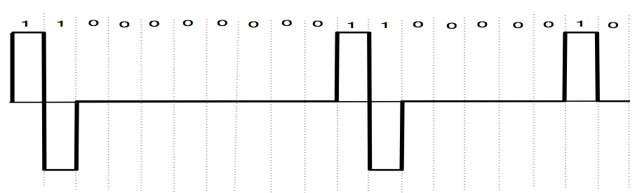
B8ZS - Example
Suppose that we want to encode the message m=1100000000110000010

Slide 48
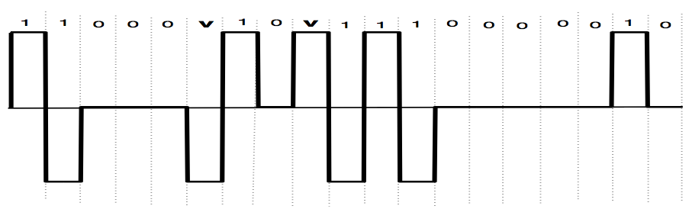
B8ZS – Example (Continue)

Slide 49
Transmission
Transmission bandwidth: the transmission bandwidth of a communication system is the band of frequencies allowed for signal transmission, in another word it is the band of frequencies at which we are allowed to use to transmit the data.

Slide 50
Bit Rate
Bit Rate : is the number of bits transferred between devices per second
If each bit is represented by a pulse of width Tb, then the bit rate

Slide 51
Example – Bit rate calculation
Suppose that we have a binary data source that generates bits. Each bit is represented by a pulse of width Tb = 0.1 mSec
Calculate the bit rate for the source
Solution

Slide 52
Example – Bit rate calculation
Suppose we have an image frame of size 200x200 pixels. Each pixel is represented by three primary colors red, green and blue (RGB). Each one of these colors is represented by 8 bits, if we transmit 1000 frames in 5 seconds what is the bit rate for this image?

Slide 53
Example – Bit rate calculation
We have a total size of 200x200 = 40000 pixels
Each pixel has three colors, RGB that each of them has 8 bits.
3 x 8 = 24 bits ( for each pixel with RGB)
Therefore, for the whole image we have a total size of 24 x 40000 = 960000 bits
Since we have 1000 frames in 5 seconds, then the total number of bits transmitted will be 1000 x 960000 = 960000000 bits in 5 seconds
Bit rate = 96000000/5 = 192000000 bits/second

Slide 54
Baud rate (Symbol rate)
The number of symbols transmitted per second through the communication channel.
The symbol rate is related to the bit rate by the following equation:
Rb = bit rate
Rs = symbol rate
N = Number of bits per symbol

Slide 55
Baud rate (Symbol rate)
We usually use symbols to transmit data when the transmission bandwidth is limited
For example, we need to transmit a data at high rate and the bit duration Tb is very small; to overcome this problem we take a group of more than one bit, say 2, therefore :

Slide 56
Baud rate (Symbol rate)
We notice that by transmitting symbols rather than bits we can reduce the spectrum of the transmitted signal.
Hence, we can use symbol transmission rather than bit transmission when the transmission bandwidth is limited

Slide 57
Example
A binary data source transmits binary data, the bit duration is 1µsec, Suppose we want to transmit symbols rather than bits, if each symbol is represented by four bits. what is the symbol rate?
Each bit is represented by a pulse of duration 1µ second, hence the bit rate

Slide 58
Example (Continue)
Therefore, the symbol rate will be

